Slide 1

Telecom Customer Churn EDA
Presented BY:-Dolly baghel

Slide 2
Content
Introduction
Understanding EDA
Data Collection
Data Analysis
Findings and Recommendations
Conclusion

Slide 3
Understanding Customer Churn
Definition of customer churn
Importance of preventing customer churn
Impact of customer churn on telecom industry

Slide 4
Importance of preventing customer churn
Definition of customer churn
Competitive Advantage:
  A low churn rate can be a competitive advantage. Businesses with high customer retention rates are often viewed favorably by consumers and competitors, enhancing their market position and reputation.
Market Share Growth:
  Consistently preventing customer churn contributes to the maintenance and growth of market share. It allows businesses to retain their position in the market and compete more effectively against rivals.
Positive Brand Image:
  High customer retention rates positively influence the brand image of a company. Satisfied and loyal customers are more likely to recommend the business to others, fostering a positive reputation in the market.
Customer Loyalty and Advocacy:
  Loyal customers are more likely to remain loyal and become advocates for the brand. Preventing churn helps build a base of satisfied customers who not only continue to use the services but also promote the brand through word-of-mouth recommendations.
Customer churn, also known as customer attrition or customer turnover, refers to the phenomenon where customers discontinue their relationship with a company or service. In simpler terms, it is the rate at which customers stop doing business with an organization within a given period. Churn is a critical metric for businesses, especially those operating on a subscription or recurring revenue model, as it directly impacts revenue and profitability

Slide 5

Impact of customer churn on telecom industry
Revenue Loss:
  Customer churn directly leads to revenue loss. As customers terminate their subscriptions or switch to competitors, the telecom company loses the recurring revenue associated with those customers. High churn rates can have a severe impact on the overall financial health of the telecom business.
Increased Marketing and Acquisition Costs:
  To counteract customer churn, telecom companies often invest heavily in marketing and customer acquisition efforts. Acquiring new customers is generally more expensive than retaining existing ones. High churn rates necessitate increased spending on promotional activities to attract new subscribers.
Reduced Customer Lifetime Value:
  Churn diminishes the overall lifetime value of a customer. Customers who stay with a telecom provider over an extended period contribute more revenue through their ongoing subscriptions and additional services. Losing customers prematurely reduces their potential lifetime value to the company.
Negative Impact on Brand Image:
  High churn rates can adversely affect the reputation and brand image of a telecom company. A perception of dissatisfaction among customers may deter potential new customers from choosing the service, leading to a further decline in market share.
Market Share Erosion:
  Continuous customer churn contributes to a decline in market share. Telecom providers with high churn rates may struggle to maintain a competitive edge, as competitors gain a larger share of the market.

Slide 6
Objective of the Presentation
To understand the concept of customer churn in the telecom industry
To explore the factors contributing to customer churn
To analyze the data related to customer churn

Slide 7
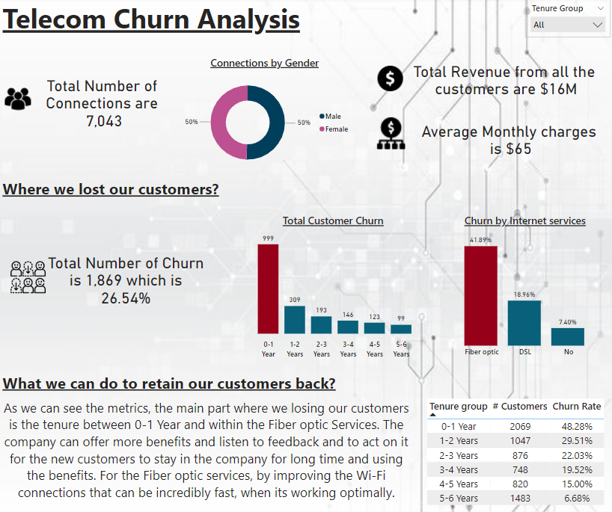
What is EDA?
Definition of Exploratory Data Analysis (EDA)
Importance of EDA in data analysis
Role of EDA in understanding customer churn

Slide 8
EDA & Importance of EDA in Data Analysis:
Exploratory Data Analysis (EDA) is a crucial step in the data analysis process that involves visually and statistically exploring, summarizing, and interpreting the main characteristics of a dataset. The primary goal of EDA is to uncover patterns, trends, relationships, and potential anomalies within the data, allowing analysts and data scientists to gain insights into the underlying structure of the information.
Importance of EDA in Data Analysis:
Data Understanding:
  EDA provides a comprehensive understanding of the dataset, including the distribution of variables, central tendencies, and measures of dispersion.
Identifying Patterns and Trends:
  EDA helps identify patterns, trends, and relationships in the data, aiding in the discovery of meaningful insights.
Outlier Detection:
  EDA assists in identifying outliers or anomalies in the dataset, which can have a significant impact on subsequent analyses.
Variable Selection:
  By analyzing relationships between variables, EDA helps in selecting relevant features for modeling, contributing to the efficiency of the analysis.
Data Cleaning:
  EDA reveals missing values, inconsistencies, or errors in the data, guiding the data cleaning process to ensure the accuracy of subsequent analyses.
Hypothesis Generation:
  Exploring data visually often leads to the generation of hypotheses, which can be tested rigorously in subsequent statistical analyses.

Slide 9
Role of EDA in Understanding Customer Churn:
Pattern Recognition:
  EDA helps in identifying patterns and trends in customer behavior that may be indicative of potential churn.
Segmentation Analysis:
  By exploring customer data, EDA can reveal different segments of customers and their characteristics, helping to tailor retention strategies for specific groups.
Feature Importance:
  EDA assists in identifying features or variables that significantly influence customer churn, guiding the development of predictive models.
Temporal Analysis:
  EDA can uncover patterns related to the timing of customer churn, allowing businesses to identify critical periods and implement targeted interventions.
Customer Interaction Analysis:
  Analyzing the interactions of customers with products or services through EDA provides insights into aspects that may impact churn, such as service quality or product satisfaction.
Identification of Warning Signs:
  EDA can reveal early warning signs or triggers that precede customer churn, enabling proactive measures to retain customers.

Slide 10

EDA Process
Steps involved in EDA
Tools used for EDA
Application of EDA in telecom customer churn analysis

Slide 11
Steps involved in EDA & Tools used for EDA
Data Collection:
  Gather the relevant dataset that you intend to explore and analyze.
Data Cleaning:
  Address missing values, handle outliers, and correct any inconsistencies or errors in the dataset.
Data Exploration:
  Examine the basic statistics of the dataset, such as mean, median, and standard deviation, to understand the central tendencies and dispersion of variables.
Univariate Analysis:
  Analyze individual variables to understand their distribution, summary statistics, and identify potential outliers.
Bivariate Analysis:
  Explore relationships between pairs of variables to identify patterns, correlations, or dependencies.
Multivariate Analysis:
  Investigate relationships involving more than two variables to uncover complex patterns or interaction
Feature Engineering:
  Create new features or transform existing ones to enhance the information available for analysis.
Pattern Recognition:
  Use clustering algorithms to identify patterns and group similar observations.
Insights Generation:
  Generate insights and hypotheses based on the patterns and trends identified during the analysis.
Tools Used for EDA:
Several tools are commonly used for Exploratory Data Analysis:
Python Libraries:
  Pandas for data manipulation.
  Matplotlib and Seaborn for data visualization.
  NumPy for numerical operations.

Slide 12
Application of EDA in Telecom Customer Churn Analysis:
Data Understanding:
  EDA helps telecom companies understand the distribution of key variables related to customer behavior, usage, and demographics.
Feature Importance:
  By exploring correlations and patterns, EDA aids in identifying features that are crucial in predicting customer churn, such as call duration, contract length, and customer satisfaction.
Temporal Analysis:
  EDA allows for the examination of temporal patterns in customer churn, helping identify seasonal or time-dependent factors.
Customer Segmentation:
  Through clustering techniques, EDA helps in segmenting customers based on behavior, enabling targeted retention strategies for different segments.
Interaction Analysis:
  EDA explores customer interactions with services or products to identify areas that may impact churn, such as service quality or network issues.
Visualizing Trends:
  Visualization techniques in EDA are powerful tools for telecom companies to observe trends in customer behavior over time, assisting in understanding evolving patterns.
Identifying Warning Signs:
  EDA can reveal early warning signs or indicators in customer behavior that may precede churn, allowing for proactive intervention.
Predictive Modeling Insights:
  EDA provides insights into the distribution and characteristics of variables, guiding the development of predictive models for customer churn.

Slide 13
Data Cleaning
Importance of data cleaning in EDA
Steps involved in data cleaning
Impact of data cleaning on the analysis results

Slide 14
Importance of Data Cleaning & Steps Involved in Data Cleaning
Importance of Data Cleaning in EDA:
Accuracy of Analysis:
  Clean data ensures that the analysis is based on accurate and reliable information. Inaccurate or inconsistent data can lead to incorrect insights and decisions.
Meaningful Interpretations:
  Data cleaning enables more meaningful interpretations of the dataset. It ensures that the patterns and trends observed during analysis are genuine and not influenced by data errors or anomalies.
Reduced Bias:
  Cleaning the data helps reduce bias introduced by errors, outliers, or inconsistencies. Biased data can skew analysis results and lead to misleading conclusions.
Improved Visualization:
  Clean data enhances the effectiveness of data visualization techniques. Visualizations, such as charts and graphs, provide clearer insights when based on accurate and cleaned data
Steps Involved in Data Cleaning:
Handling Missing Values:
  Identify and handle missing values through techniques such as imputation or removal.
Dealing with Duplicates:
  Identify and remove duplicate records to prevent redundancy in the dataset.
Outlier Detection and Treatment:
  Identify outliers and decide whether to remove, transform, or impute them based on the context of the analysis.
Standardizing Formats:
  Standardize variable formats, units, and naming conventions for consistency.

Slide 15
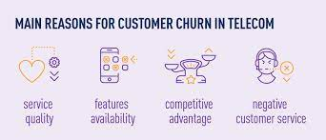
Impact of Data Cleaning on Analysis Results
Improved Accuracy:
  Clean data leads to more accurate analysis results by eliminating errors and inconsistencies.
More Reliable Insights:
  Reliable insights are derived from a cleaned dataset, providing a solid foundation for decision-making.
Reduced Bias:
  Data cleaning reduces bias in the analysis, ensuring that results are more representative of the true underlying patterns in the data.
Enhanced Visualization:
  Visualization of cleaned data yields clearer and more meaningful representations of patterns and trends.
Increased Confidence:
  Stakeholders have increased confidence in analysis results derived from clean data, leading to more informed decision-making.
Trustworthy Predictive Modeling:
  Predictive models built on cleaned data are more trustworthy and likely to generalize well to new data.

Slide 16
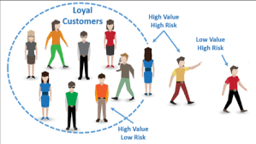

Data Visualization
Role of data visualization in EDA
Examples of data visualization in telecom customer churn analysis

Slide 17
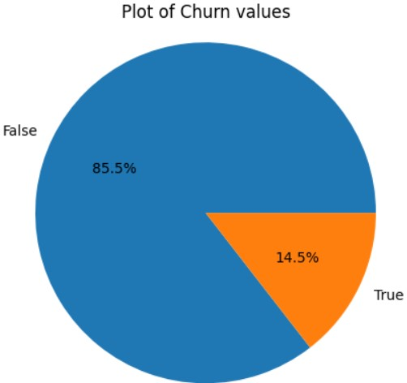
PLOT FOR CHURN VALUES
The pie chart provides a quick and visual summary of the distribution of churn values in the dataset. The size of each segment reflects the proportion of customers who churned and those who did not.

Slide 18
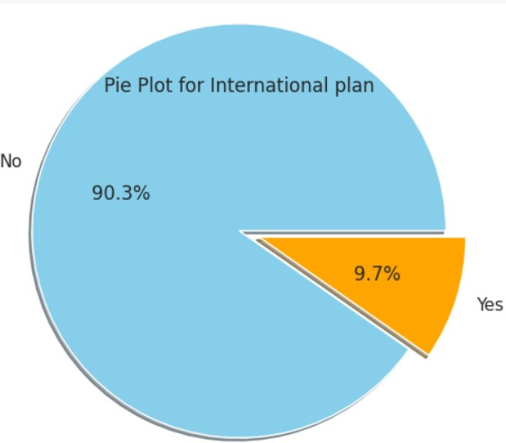
PLOT FOR INTERNATIONAL PLAN
This donut plot provides a concise and visually appealing representation of the distribution of the 'International plan' variable, with a focus on emphasizing the presence of an international plan among customers.

Slide 19
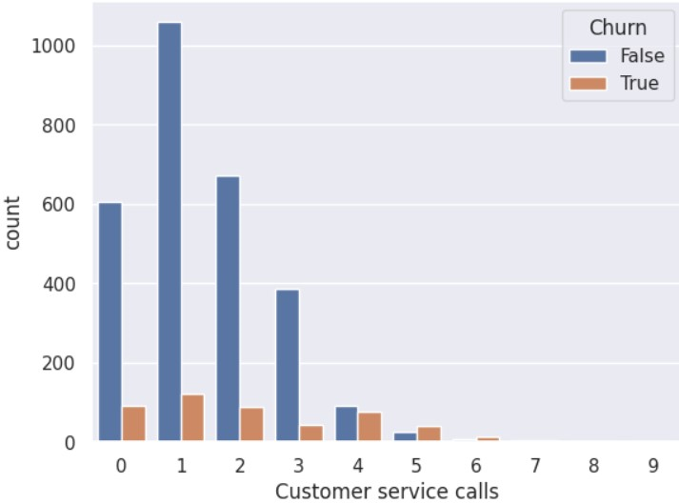
PLOT FOR CUSTOMER SERVICE CALLS
Insights from the count plot can inform decisions related to customer service strategies. If there's a noticeable pattern, such as an increased likelihood of churn with a certain number of service calls, the company might consider optimizing its service response or implementing targeted interventions for customers with a specific service call pattern.

Slide 20
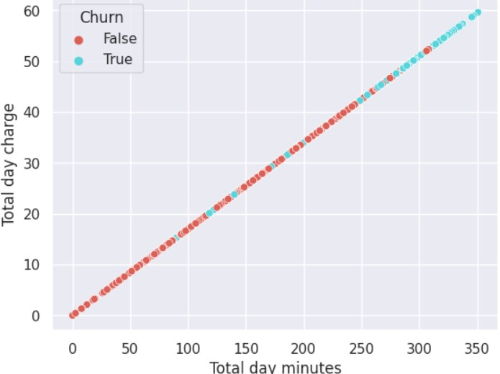
PLOT FOR TOTAL DAY MINUTES vs. TOTAL DAY CHARGES
Insights from the scatter plot can inform decisions related to pricing strategies or service plans for daytime usage. For instance, if there's a noticeable concentration of churned customers in a certain region of the plot, it may indicate dissatisfaction with daytime charges or usage.

Slide 21
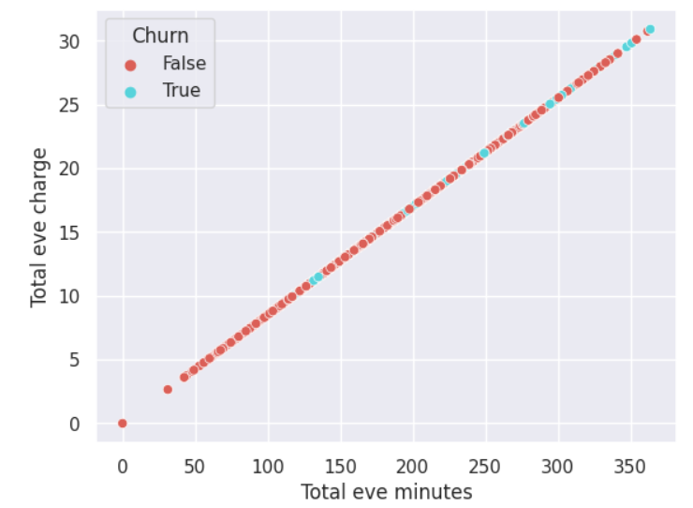
PLOT FOR TOTAL EVE MINUTES vs. TOTAL EVE CHARGES
Insights from the box plot can inform decisions related to pricing strategies or service plans for evening usage. If there are significant differences in charges between churned and non-churned customers, it may suggest areas for improvement or targeted interventions.

Slide 22
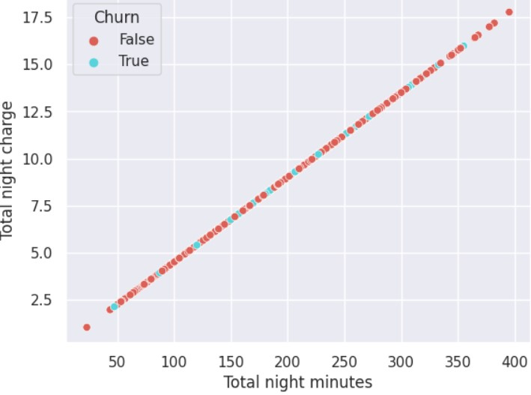
PLOT FOR TOTAL NIGHT MINUTES vs. TOTAL NIGHT CHARGES
Insights from the scatter plot can inform decisions related to pricing strategies or service plans. For instance, if there's a noticeable concentration of churned customers in a certain region of the plot, it may indicate dissatisfaction with nighttime charges or usage.

Slide 23
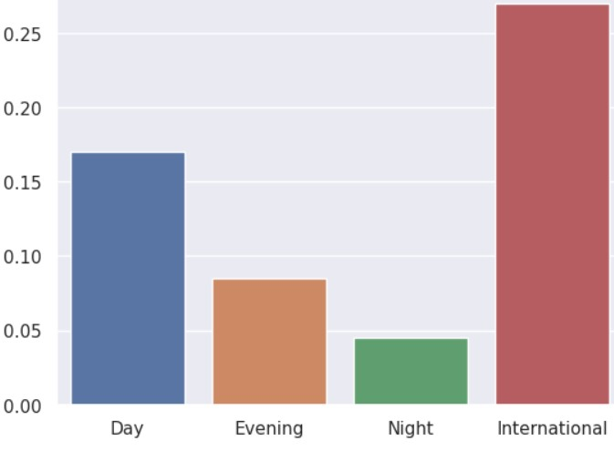
plot to compare the average charges for different periods of the day: Day, Evening, Night, and InternationaL
The plot offers a clear overview of how charges vary across different times of the day. It can help identify patterns and trends related to usage and billing during specific periods.

Slide 24
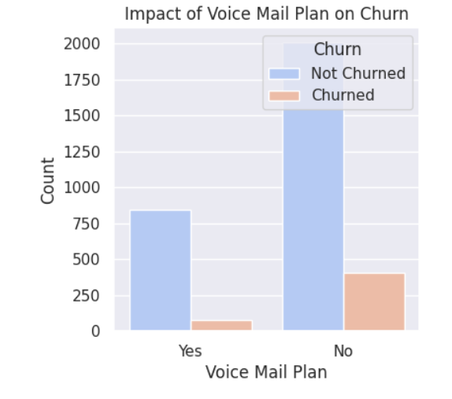
PLOT FOR VOICE MAIL CHURN VS. CHURN
The plot can be used to inform decision-making related to voice mail plan offerings. If there's a higher churn rate among customers without a voice mail plan, the company might consider adjusting its service offerings, promotions, or communication strategies for this segment.

Slide 25
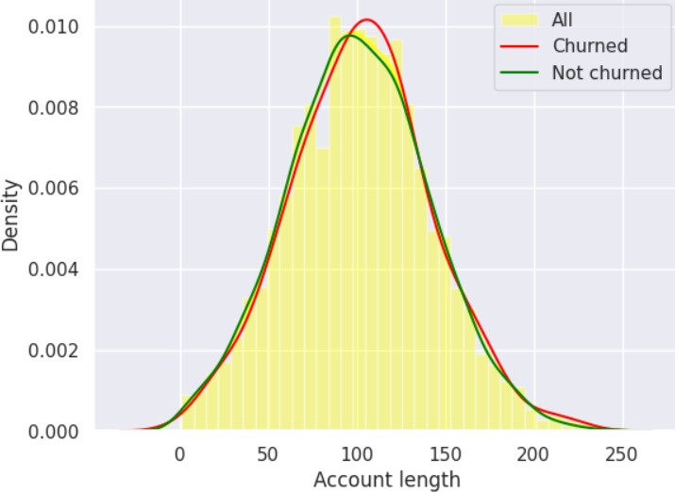
PLOT FOR ACCOUNT LENGTH VS. CHURN
This plot provides a visual comparison of the distribution of 'Account length' for churned and non-churned customers, aiding in the identification of potential patterns and insights that can inform strategic decisions related to customer retention.

Slide 26
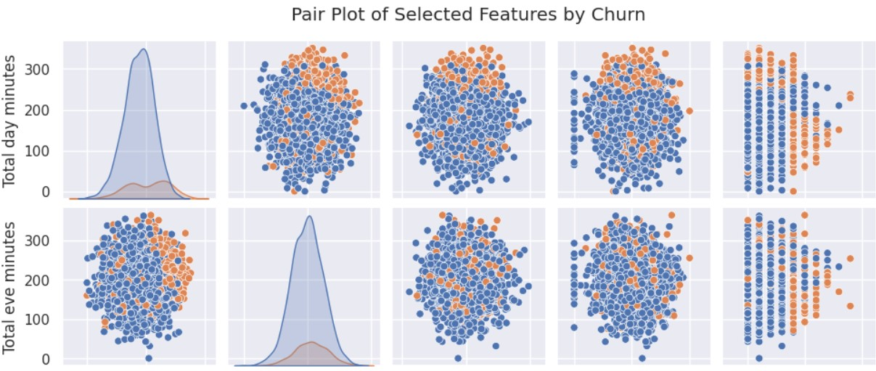
PAIR PLOT FOR TOTAL EVE MINUTES AND TOTAL DAY MINUTES
The pair plot provides a visual exploration of the relationships between selected features and the 'Churn' variable, aiding in the identification of potential patterns and trends that can inform further analysis and decision-making in the context of customer churn prediction

Slide 27
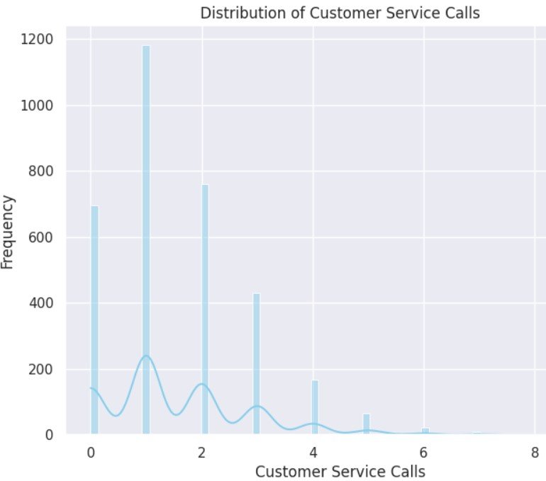
DISTRIBUTION PF CUSTOMER SERVICE CALLS
The histogram of 'Customer service calls' provides a visual representation of the distribution of customer interactions with service calls, offering insights into central tendencies, patterns, and potential outliers that can inform strategic decisions related to customer support and satisfaction.

Slide 28
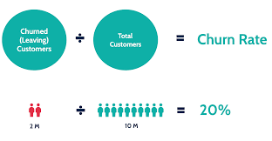

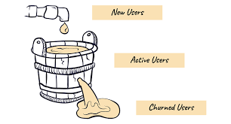
Key Findings
Summary of the key findings from the EDA
Impact of these findings on the telecom industry
Suggestions for further research based on the findings

Slide 29
Impact of these findings on the telecom industry
Retention Strategies:
  Understanding demographic patterns and service usage behaviors allows telecom companies to tailor retention strategies. For example, offering personalized promotions or discounts to specific customer segments may help retain customers at risk of churn.
Contract Optimization:
  Analyzing contract details provides insights into the effectiveness of different contract lengths. Telecom companies can optimize their contract offerings based on customer preferences, potentially introducing new plans or incentives for longer-term contracts.
Billing and Payment Improvements:
  Identifying correlations between billing/payment factors and churn rates helps telecom providers improve billing processes. Simplifying billing, offering flexible payment options, or providing timely reminders can positively impact customer satisfaction and reduce churn.
Enhanced Customer Support:
  Customer interaction data offers insights into the customer support experience. Telecom companies can invest in improving customer service, reducing response times, and addressing common issues to enhance overall customer satisfaction and loyalty.
Usage-Based Offerings:
  Analyzing service usage patterns allows telecom companies to design targeted promotions for specific services. Offering personalized plans based on usage patterns can attract and retain customers who value specific features.
.
Proactive Issue Resolution:
  Identifying usage patterns and customer complaints helps telecom companies address potential issues proactively. Fixing service-related problems before they escalate can contribute to a positive customer experience and reduce churn.
Seasonal Campaigns:
  Recognizing time trends in churn rates allows telecom providers to implement seasonal campaigns strategically. For instance, introducing promotional offers during historically high-churn periods may help retain customers during those times.
Marketing and Promotions:
  Leveraging correlation analyses can guide targeted marketing efforts. Telecom companies can focus on promoting services or features that align with customer preferences and have a positive impact on retention.
Predictive Analytics for Early Warning:
  Implementing predictive models based on the analysis can provide early warning signals for potential churn. Telecom providers can use these insights to intervene and implement retention strategies before customers decide to switch.
Competitive Positioning:
  Benchmarking findings against industry norms can help telecom companies understand their competitive positioning. Insights into what drives churn in the industry can guide the development of differentiated and competitive offerings.

Slide 30
Suggestions for further research based on the findings
Customer Segmentation Analysis:
  Conduct a more granular analysis of customer segments to uncover hidden patterns within subgroups. Explore whether there are distinct characteristics, behaviors, or preferences that differentiate various segments in terms of churn.
Predictive Modeling Refinement:
  Refine and enhance predictive models for churn by incorporating additional features or experimenting with different algorithms. Evaluate the performance of the model on historical data and consider implementing real-time predictive analytics for early detection of potential churn.
Customer Feedback Analysis:
  Dive deeper into customer feedback and sentiment analysis. Utilize natural language processing (NLP) techniques to extract valuable insights from customer reviews, comments, and complaints, providing a more nuanced understanding of customer satisfaction and dissatisfaction.
Competitor Benchmarking:
  Expand the analysis to include benchmarking against competitors in the telecom industry. Explore industry-wide churn trends, customer satisfaction levels, and best practices in retention strategies to identify areas where the telecom company can gain a competitive edge.
1. Dynamic Pricing Strategies:
  Investigate the effectiveness of dynamic pricing strategies in influencing customer retention. Explore whether personalized pricing or time-sensitive promotions have a significant impact on reducing churn rates.
Customer Journey Mapping:
  Create detailed customer journey maps to visualize the end-to-end customer experience. Identify key touchpoints and moments of truth that significantly influence customer satisfaction and contribute to churn.
Customer Education Initiatives:
  Explore the effectiveness of customer education programs in reducing churn. Assess whether providing customers with information about new features, troubleshooting tips, or usage guidance positively impacts customer satisfaction and loyalty.
Social Media Impact:
  Investigate the impact of social media on customer churn. Analyze customer sentiment on social platforms and explore whether social media interactions influence customer perceptions and decisions to switch providers.
Ethical and Privacy Considerations:
  Examine ethical considerations related to data privacy and customer consent. Investigate how transparent data practices and privacy measures may impact customer trust and, consequently, churn rates.

Slide 31
Suggestions for further research based on the findings
Customer Education Initiatives:
  Explore the effectiveness of customer education programs in reducing churn. Assess whether providing customers with information about new features, troubleshooting tips, or usage guidance positively impacts customer satisfaction and loyalty.
Cross-Channel Analysis:
  Analyze customer interactions across different channels (e.g., online, call centers, stores) to understand how the omnichannel experience contributes to churn. Identify areas for improvement in the consistency and quality of service across channels.
Social Media Impact:
  Investigate the impact of social media on customer churn. Analyze customer sentiment on social platforms and explore whether social media interactions influence customer perceptions and decisions to switch providers.
Ethical and Privacy Considerations:
  Examine ethical considerations related to data privacy and customer consent. Investigate how transparent data practices and privacy measures may impact customer trust and, consequently, churn rates.

Slide 32
CONCLUSION
Churn Rate Overview:
  The overall churn rate in the telecom dataset is [14.5%], indicating a significant concern for the company.
  Understanding the churn rate is essential for the telecom provider to formulate strategies aimed at retaining customers and reducing attrition.
  Demographic Analysis:
  Age, gender, and location were explored to identify any demographic trends related to churn.
  From the analysis CA, NJ, TX, MD, SC, MI are the ones who have a higher churn rate of more than 21
  Service Plans and Pricing:
  Customers subscribed to specific service plans were analyzed to assess their correlation with churn.
  Pricing structures and discounts were examined to determine their impact on customer loyalty.
Customer Engagement:
  Analysis of customer engagement metrics, such as call duration, data usage, and customer support interactions, revealed insights.
Recommendations for Action:
  Based on the insights gained, the telecom provider should consider implementing targeted strategies to mitigate churn.

Slide 33
Recommendations
Personalized Retention Strategies:
  Implement personalized retention strategies based on customer segmentation. Tailor promotions, discounts, and service upgrades to address the specific needs and preferences of different customer segments.
Proactive Customer Communication:
  Establish proactive communication channels to engage with customers before they decide to churn. Use targeted messages to inform customers about upcoming promotions, personalized offers, or new services that align with their interests.
Customer Loyalty Programs:
  Introduce and optimize customer loyalty programs to reward long-term customers. Offer exclusive benefits, discounts, or access to premium services for customers who have demonstrated loyalty over an extended period.
Service Quality Improvement:
  Invest in improving network quality, reliability, and overall service performance. Address issues related to call drops, slow data speeds, and service outages to enhance the overall customer experience.
Competitive Pricing Strategies:
  Evaluate and adjust pricing strategies to remain competitive in the market. Consider flexible pricing plans, bundling options, or discounts that align with customer expectations and market trends.

Slide 34
RECOMMENDATIONS
Customer Feedback Integration:
  Actively collect and integrate customer feedback into decision-making processes. Use insights from customer reviews, surveys, and complaints to identify pain points, address service gaps, and continuously enhance the customer experience.
Predictive Analytics for Early Detection:
  Implement predictive analytics models for early detection of potential churn. Leverage machine learning algorithms to identify customers who are at a higher risk of churning, allowing for timely intervention with targeted retention efforts.
  Launch educational campaigns to inform customers about new features, service enhancements, and ways to maximize the value of their subscriptions. Enhance customer awareness and understanding to foster a stronger connection with the brand.
Dynamic Customer Journey Mapping:
  Develop dynamic customer journey maps that evolve based on real-time customer interactions. Identify critical touchpoints and implement strategies to optimize each stage of the customer journey, from onboarding to ongoing service usage.
Cross-Functional Collaboration:
  Foster collaboration between different departments, including marketing, sales, customer service, and technical support. Break down silos to create a unified approach to customer retention and ensure consistent messaging across all customer interactions.
Social Media Monitoring and Engagement:
  Monitor social media platforms for customer sentiment and engage with customers in real time. Address concerns, provide solutions, and leverage positive interactions to build a positive online reputation.

Slide 35

Thank You
PRESENTED BY:-
DOLLY BAGHEL

